Slide 1

Operation Analytics and Investigating Metric Spike
Mohak Shah

Slide 2
Project Overview
Purpose
      To investigate and resolve operational inefficiencies through data analysis.
      Provide actionable insights into job performance and user engagement.
Focus Areas
      Job Data Analysis.
      Metric Spike Investigation.

Slide 3
Tech Stack
MySQL Workbench 8.0 CE
      For running SQL queries.
      Easy-to-Use Interface for query execution.
MySQL Shell
      Efficient for database management and querying.
      Simple for capturing analysis.
Microsoft PowerPoint
      For presenting report.

Slide 4
Case Study 1: Job Data Analysis
Objective: Analyze operational performance metrics related to job reviews.
Dataset: job_data
    Columns:
      job_id
      actor_id
      event
      language
      time_spent
      org
      ds

Slide 5
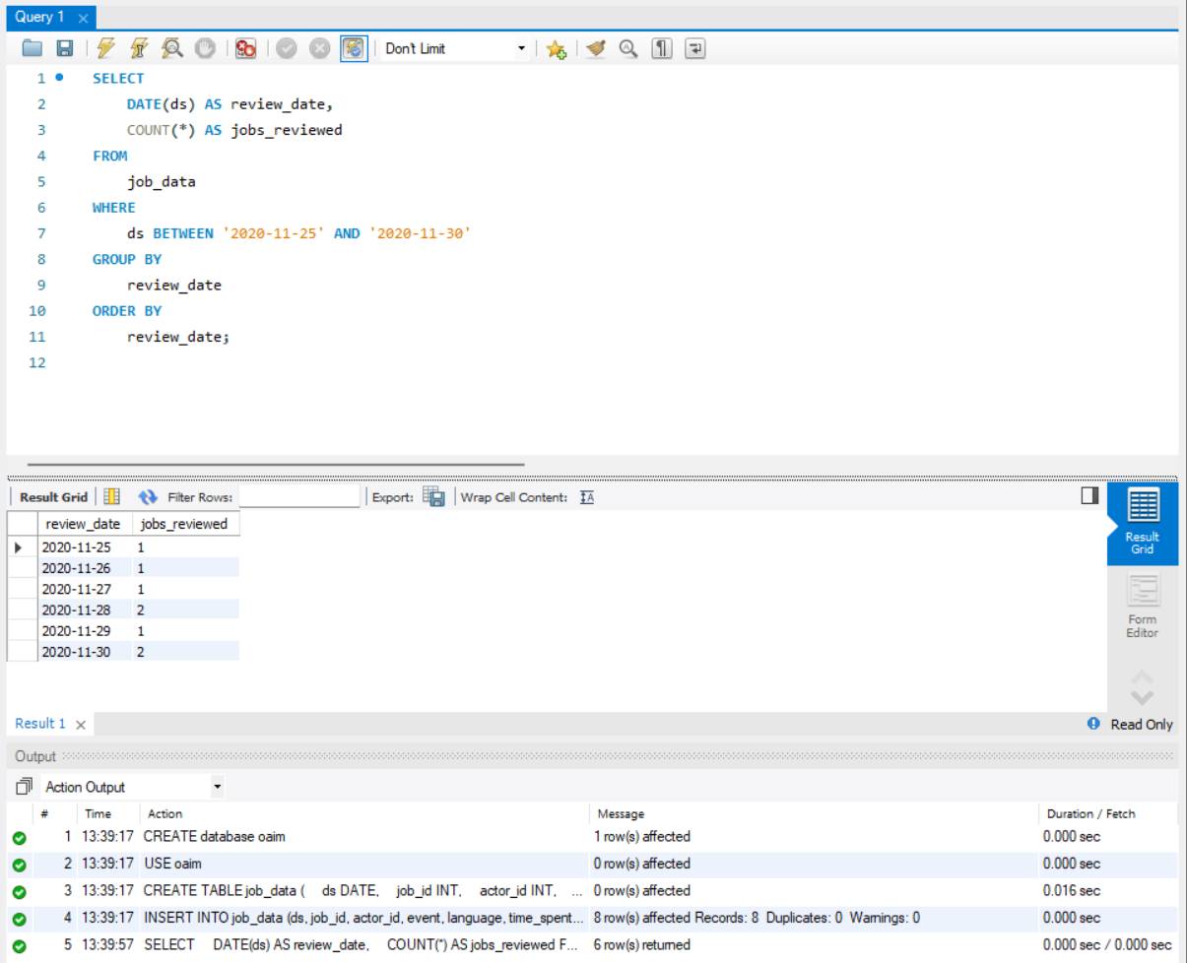
Jobs Reviewed Over Time
Objective: Calculate the number of jobs reviewed per hour for each day in November 2020.
SQL Query:
Insight: Peak hours for job reviews indicate optimal resource allocation times.

Slide 6
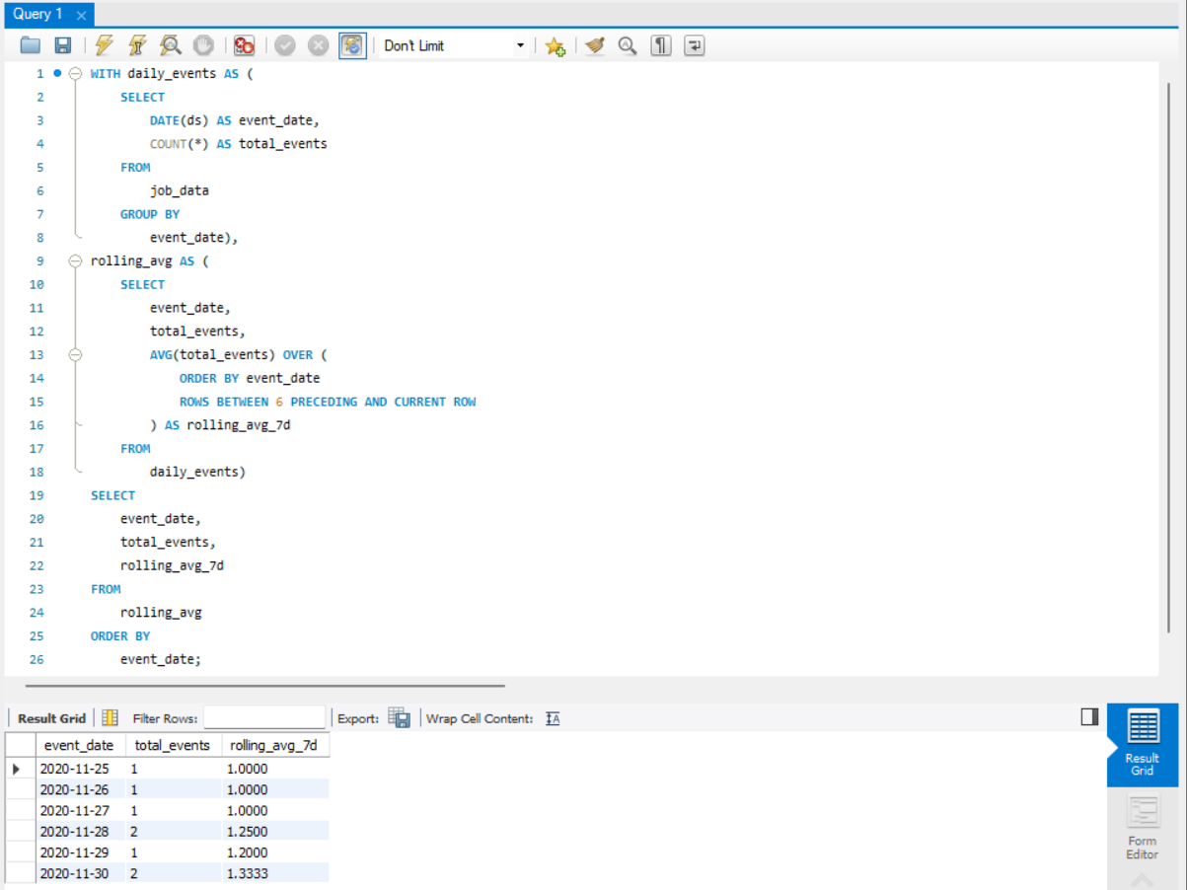
Throughput Analysis
Objective: Calculate the 7-day rolling average of throughput.
SQL Query:
Insight: 7-day rolling average for smoother trends and long-term decisions.

Slide 7
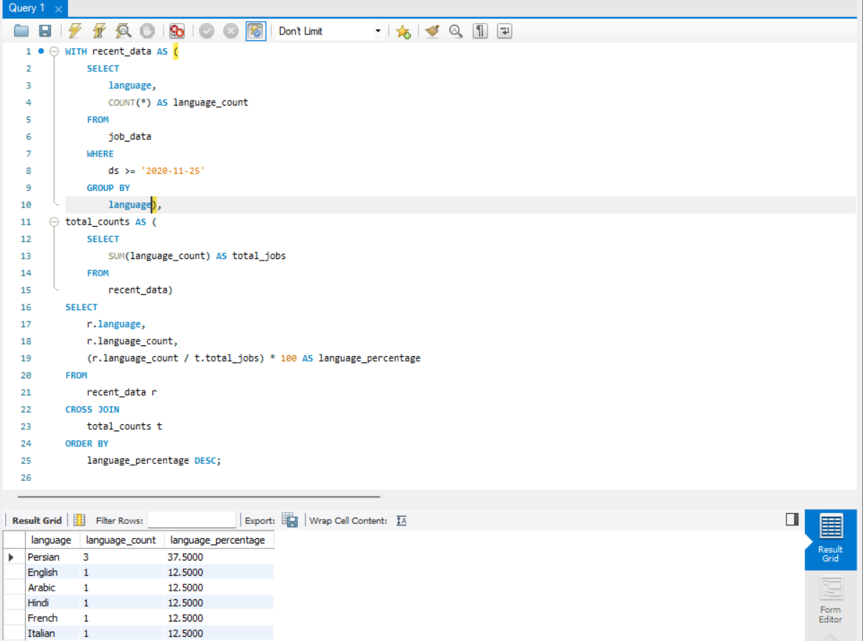
Language Share Analysis
Objective: Calculate the percentage share of each language over the last 30 days.
SQL Query:
Insight: Most-used languages guide localization efforts.

Slide 8
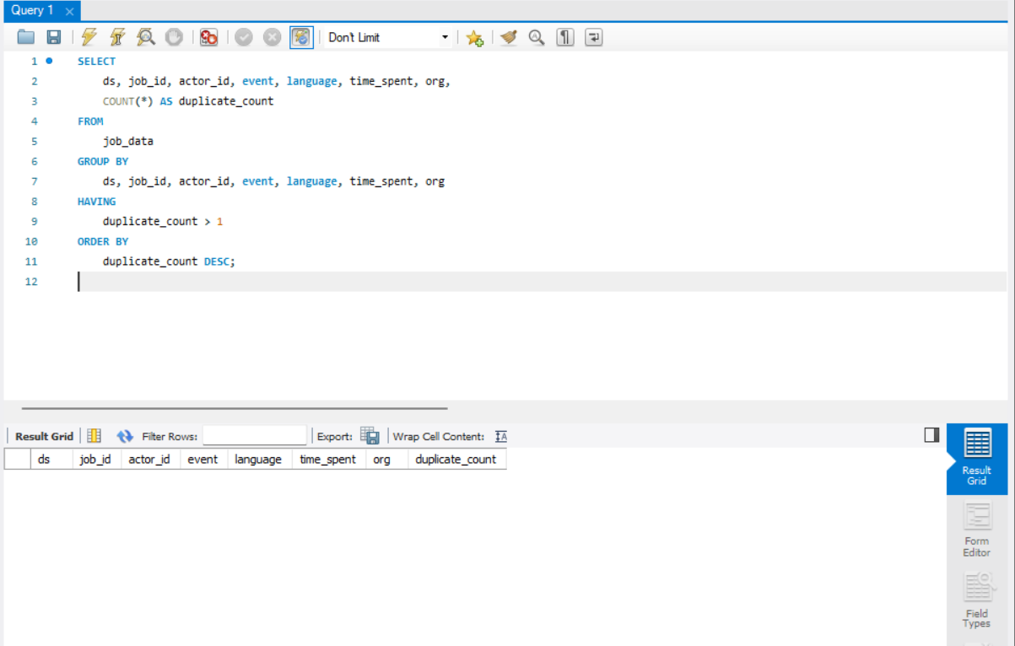
Duplicate Rows Detection
Objective: Identify duplicate rows in “job_data”.
SQL Query:
Insight: Cleaned up duplicates to ensure data accuracy.

Slide 9
Case Study 2: Investigating Metric Spikes
Objective: Investigate sudden changes in user engagement and email interactions.
Datasets:
      users : User details.
      events : User activity records.
      email_events : Email-specific events.

Slide 10
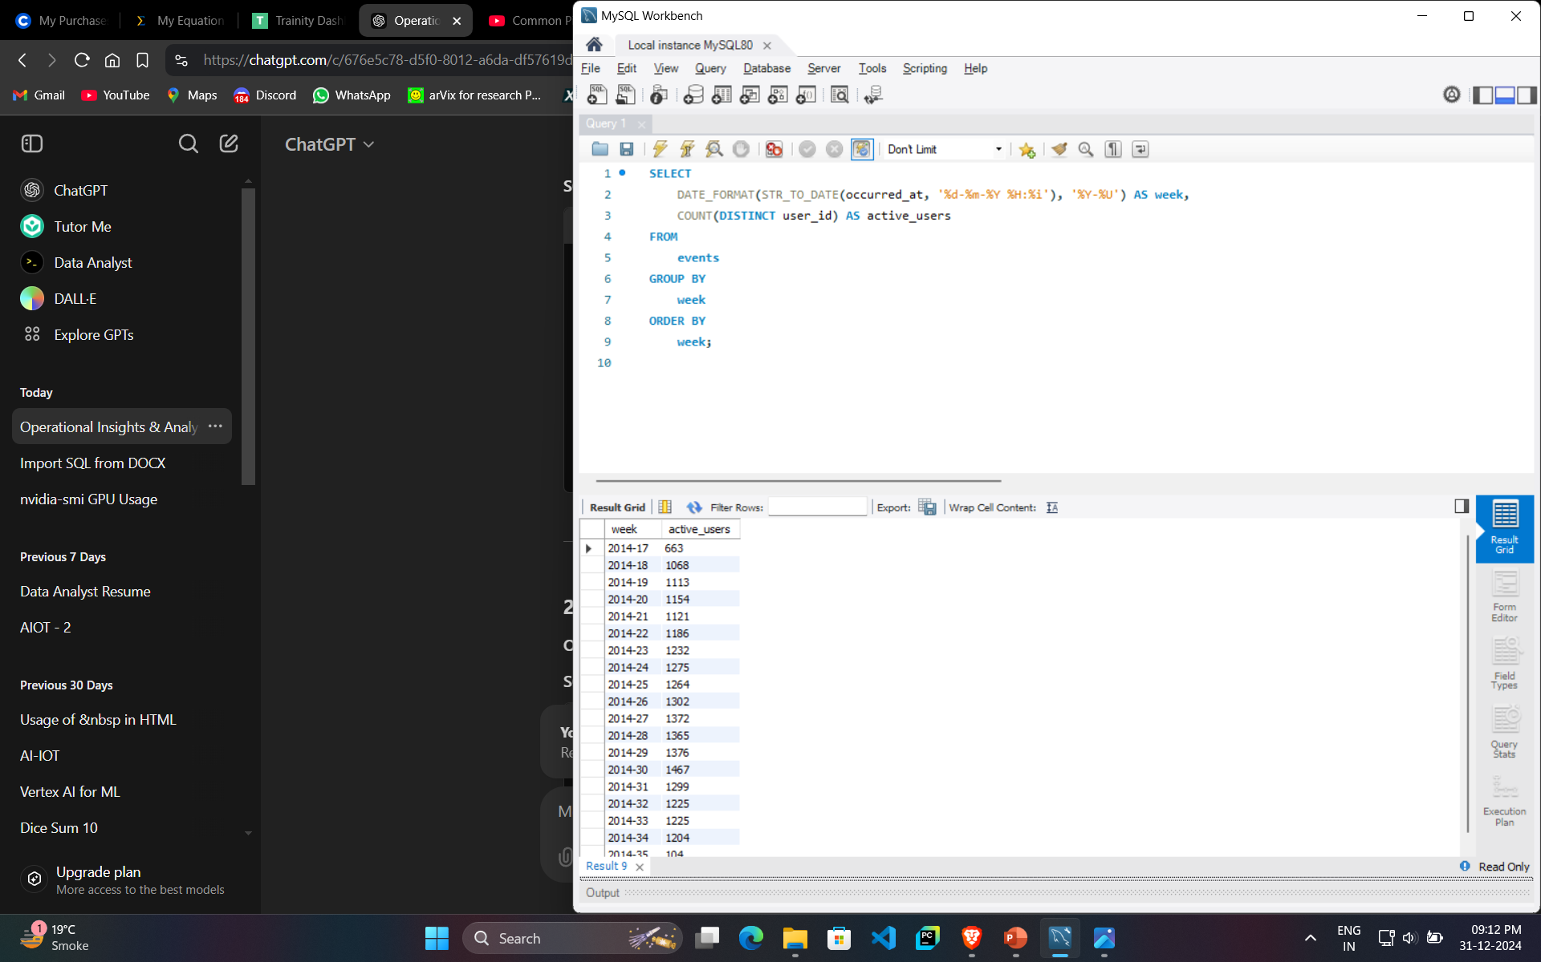
Weekly User Engagement
Objective: Measure the activeness of users on a weekly basis.
SQL Query:
Insight: Indicates the number of distinct active users per week, helping identify trends and fluctuations in user engagement.

Slide 11
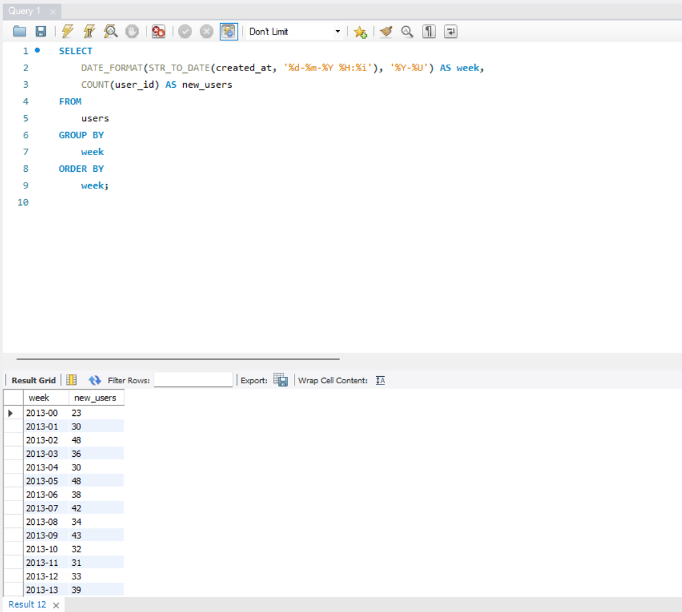
User Growth Analysis
Objective: Analyze the growth of users over time for a product.
SQL Query:
Insight: Tracks new user signups weekly, allowing for trend analysis to identify periods of high growth and evaluate the impact of product launches or marketing efforts.

Slide 12
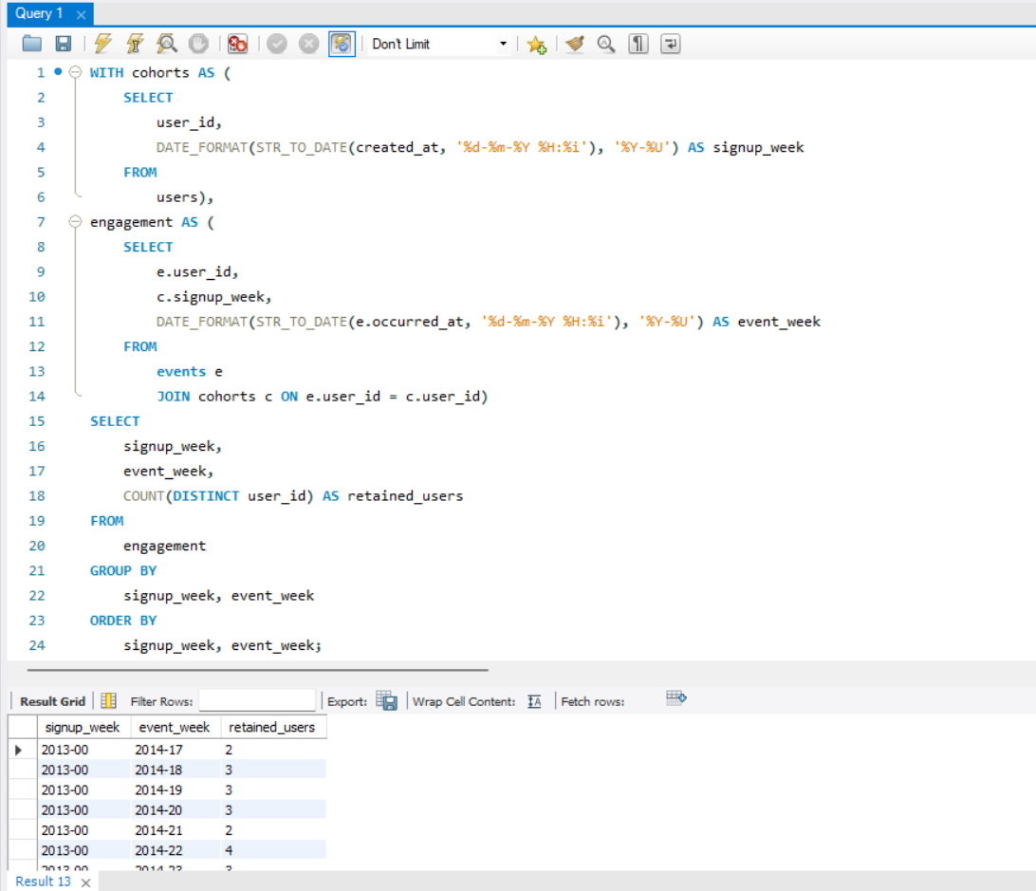
Weekly Retention Analysis
Objective: Analyze the retention of users on a weekly basis after signing up for a product.
SQL Query:
Insight: The query tracks weekly user retention by signup cohort to identify churn trends.

Slide 13
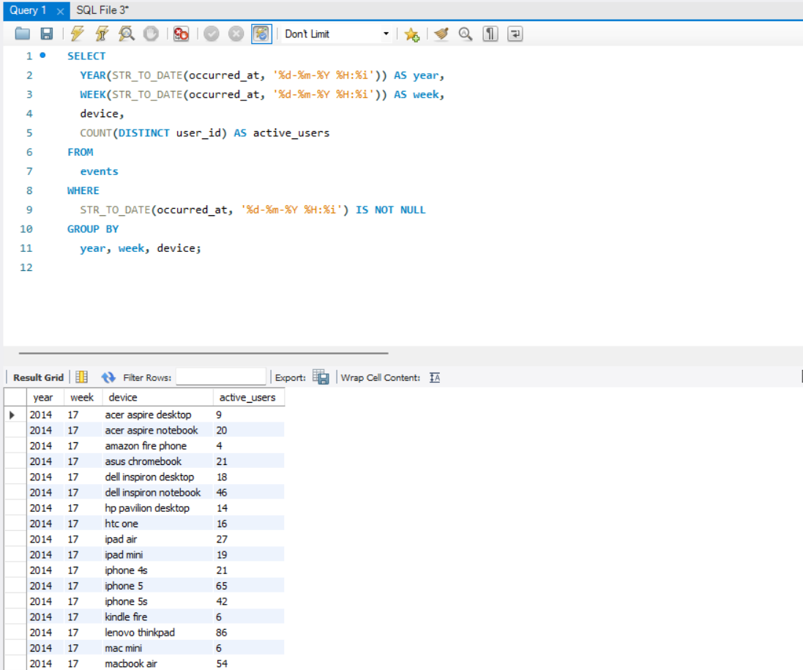
Weekly Engagement Per Device
Objective: Measure user activeness on a weekly basis per device.
SQL Query:
Insight: Tracks weekly engagement per device to identify potential usability issues.

Slide 14
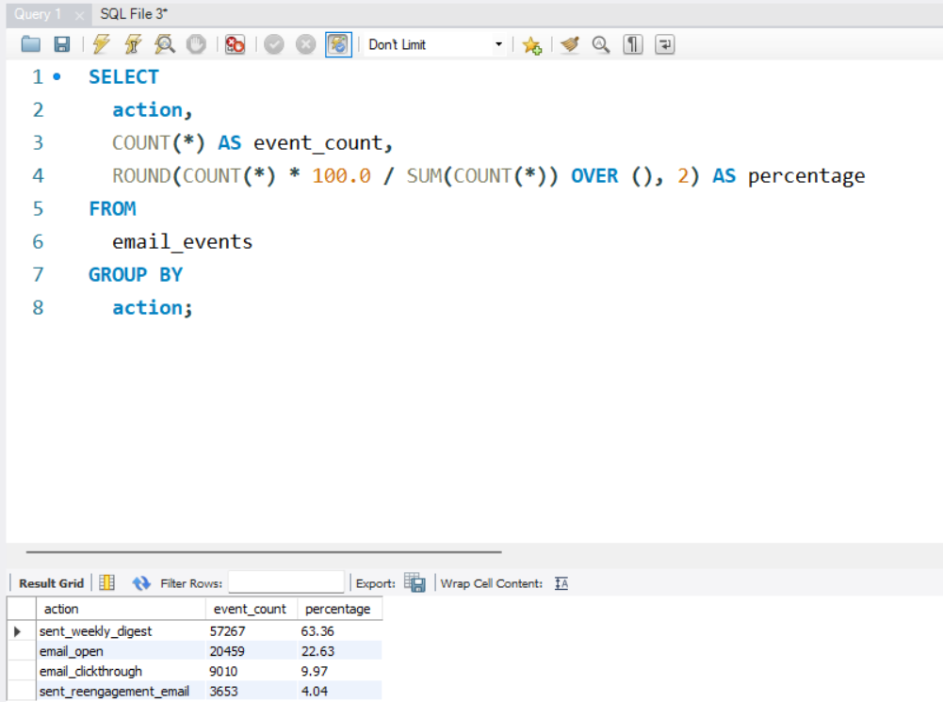
Email Engagement Analysis
Objective: Analyze how users are engaging with the email service.
SQL Query:
Insight: The query calculates email engagement rates, highlighting content or targeting issues.

